Slide 1
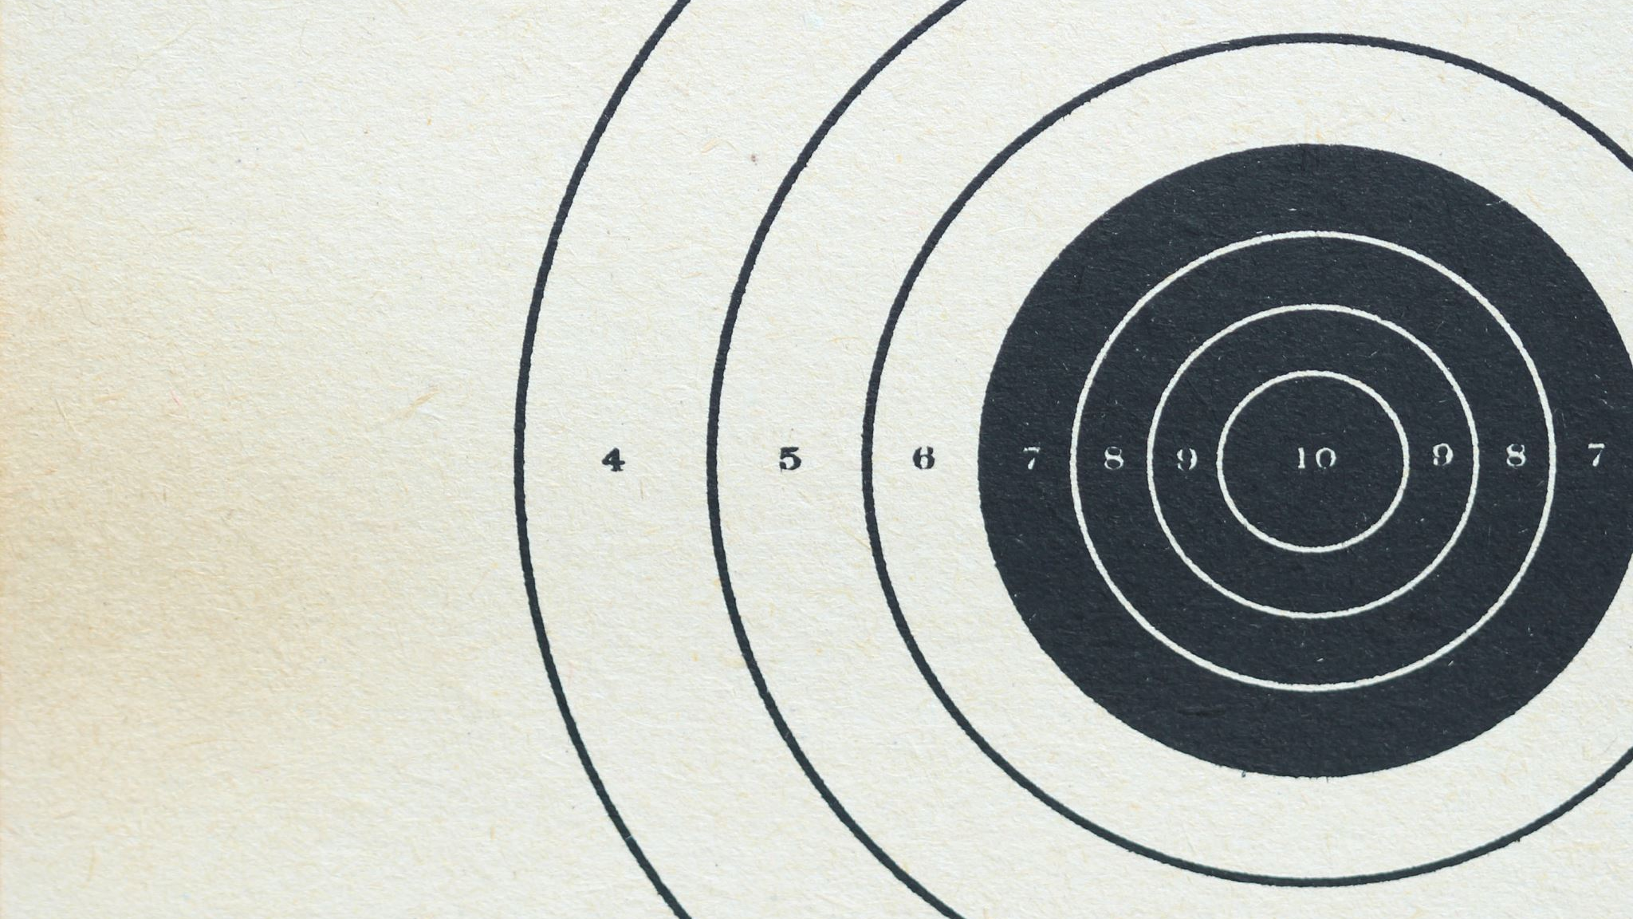
Sonar
DETECTION OVER MINE AND A ROCK

Slide 2
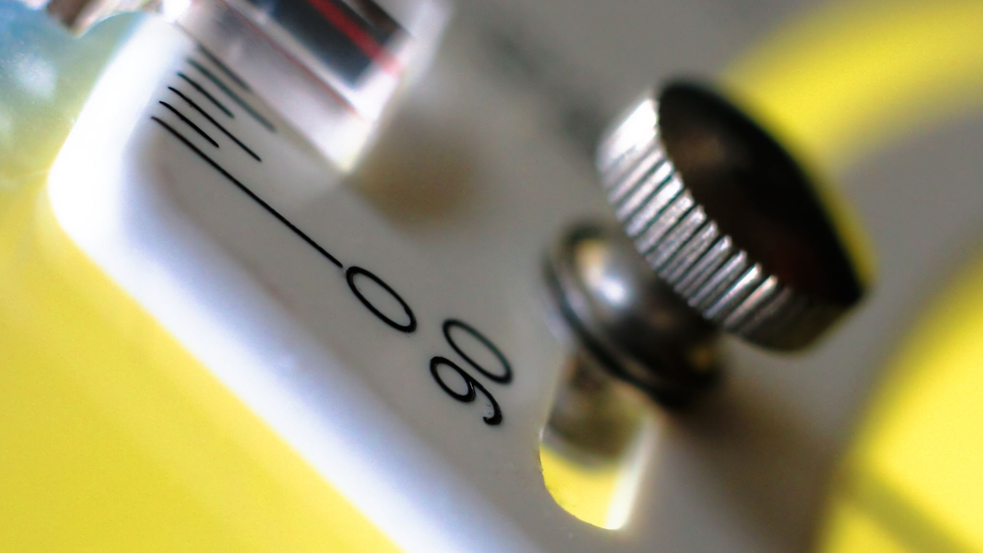
Abstract
Sonar (sound navigation and ranging or sonic navigation and ranging)is a technique that uses sound propagation (usually underwater, as in submarine navigation) to navigate, measure distances (ranging), communicate with or detect objects on or under the surface of the water.
Sonar detection technology plays a crucial role in distinguishing between mines and rocks underwater. The primary objective is to enhance the accuracy and reliability of sonar systems in identifying potential threats such as naval mines, while minimizing false positives from harmless rocks. This abstract reviews the principles of sonar operation, including the emission and reflection of sound waves, and the interpretation of the resulting echo patterns. Key factors influencing detection capabilities are discussed, such as the material composition, shape, and size of both mines and rocks, as well as the environmental conditions like water temperature, salinity, and depth.
Advanced signal processing techniques, including machine learning algorithms and pattern recognition, are highlighted for their potential to improve differentiation between these objects. Recent advancements in sonar technology.

Slide 3

Existing systems
There are several advanced sonar systems currently being used and developed for mine detection, which demonstrate significant capabilities in distinguishing mines from rocks and other underwater objects.
This sonar mine detection set includes a combination of various sensors, such as Wideband Forward-Looking Sonar, Multi-Function Side-Look Synthetic Aperture Sonars, and Digital Gap Fill Sonar. These technologies enable the detection, classification, and localization of mines.
Another advanced technology is the Synthetic Aperture Sonar (SAS), which offers superior resolution compared to traditional Real Aperture Sonar (RAS). SAS uses lower frequency acoustics, allowing for greater range and finer resolution images of the seafloor, which significantly improves mine detection capabilities.
These systems highlight the ongoing efforts to enhance sonar technologies for mine detection, ensuring higher precision and safer operations in mine-infested waters.

Slide 4

Proposed system
Suppose there is a war between countries and we have assigned submarines to check whether there is rock or a mine inside water.
Mines are explosives that explode when some object come in contact with it. And there can be rocks as well in the ocean.
Submarines have to predict whether it is crossing a mine or a rock. So, we have to build a system to predict whether the object beneath the submarine is mine or rock.
Submarine uses a sonar that sends sound signal and reviews switch back of the signal. So, this signal is then processed to detect whether the object is mine or just a rock in the ocean.
These sound waves can travel for hundreds of miles under water, and can retain an intensity of 140 decibels as far as 300 miles from their source.

Slide 5
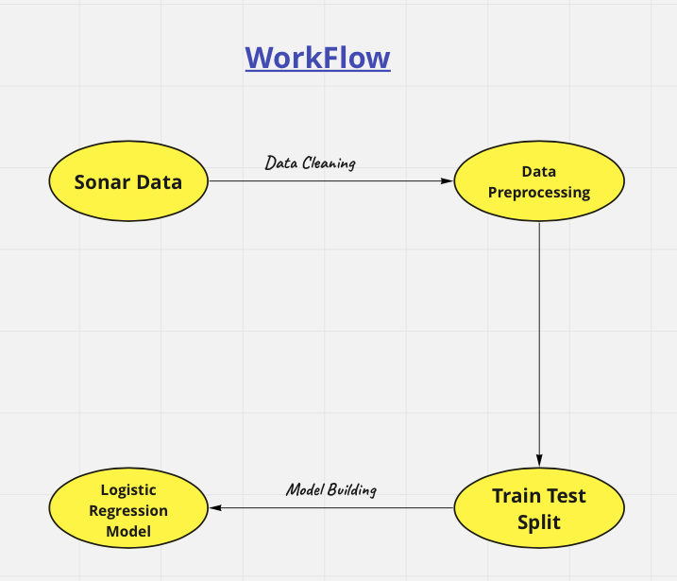
Work flow:

Slide 6
Tests and algorithms
Collect Sonar Data : Laboratory setup experiment can be done where sonar is used to send and receive signals. There is far difference between signals received from mines and rocks. Because mines will be made up of metal.
So, we collect this data which is nothing but the sonar data obtained from a rock and a metal cylinder.And later, we use this sonar data and feed it to our machine learning model.
And our model will predict whether the object is made up of metal or it is just a rock.This is the principle we are going to use in our prediction.
Data Preprocessing : We must process data for better results. In preprocessing, we do cleaning, filling missing values etc.
Train Test Split : After that, we will train our model with 80-90% of training-data and 10–20% will be used to test-data. And evaluate our model with the help of test-data.
Logistic Regression Model : Supervised machine learning algorithm used for classification tasks where the goal is to predict the probability that an instance belongs to a given class or not. Logistic regression is a statistical algorithm which analyze the relationship between two data factors. This model works very well for Binary Classification Problem. It is a Binary Classification Problem.(Rock or a Mine).
This is a Supervised Learning Algorithm.

Slide 7
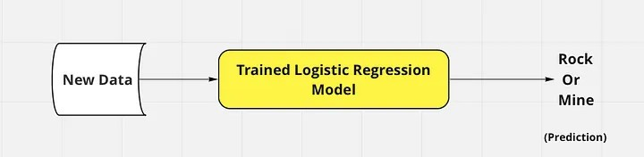
prediction

Slide 8
explaination
Load the dataset :
We load the Sonar dataset from the UCI repository and assign column names for easier handling.
Preprocess the dataset :
We separate the features (X) and the target variable (y). The target variable is converted to binary form, where 1 represents a mine and 0 represents a rock.
Split the dataset :
We split the dataset into training and testing sets using an 80-20 split.
Standardize the features :
Standardization ensures that each feature has a mean of 0 and a standard deviation of 1, which is beneficial for many machine learning algorithms.
Train the model :
We use a Random Forest classifier, which is a robust ensemble method.
Make predictions and evaluate :
We predict the labels for the test set and evaluate the model using accuracy, a classification report, and a confusion matrix.

Slide 9
CODE
import pandas as pd
from sklearn.model_selection import train_test_split
from sklearn.preprocessing import StandardScaler
from sklearn.ensemble import RandomForestClassifier
from sklearn.metrics import classification_report, accuracy_score, confusion_matrix
# Load the dataset
url = "https://archive.ics.uci.edu/ml/machine-learning-databases/undocumented/connectionist-bench/sonar/sonar.all-data"
columns = [f'Feature_{i+1}' for i in range(60)] + ['Label']
data = pd.read_csv(url, header=None, names=columns)
# Preprocess the dataset
X = data.drop('Label', axis=1)
y = data['Label'].apply(lambda x: 1 if x == 'M' else 0)

Slide 10
# Split the dataset into training and testing sets
X_train, X_test, y_train, y_test = train_test_split(X, y, test_size=0.2, random_state=42)
# Standardize the features
scaler = StandardScaler()
X_train = scaler.fit_transform(X_train)
X_test = scaler.transform(X_test)
# Train a RandomForest classifier
clf = RandomForestClassifier(n_estimators=100, random_state=42)
clf.fit(X_train, y_train)

Slide 11
# Split the dataset into training and testing
# Make predictions
y_pred = clf.predict(X_test)
# Evaluate the model
print("Accuracy:", accuracy_score(y_test, y_pred))
print("Classification Report:\n", classification_report(y_test, y_pred))
print("Confusion Matrix:\n", confusion_matrix(y_test, y_pred))

Slide 12
conclusion
The sonar prediction analysis aimed to differentiate between rocks and mines using sonar signals. Through this project, various machine learning techniques were applied to classify the sonar data accurately.
In conclusion, the sonar prediction project successfully differentiated between rocks and mines using advanced machine learning techniques. The Random Forest classifier emerged as the best-performing model, demonstrating high accuracy and reliability. This model can now be employed in practical applications, such as underwater exploration and naval defense, to enhance the safety and efficiency of these operations. Continued monitoring and periodic re-training with new data will further ensure the model's robustness and adaptability to changing environments.

Slide 13
THANKYOU

